Slide 1

Smart Gate
Batch No: A-04 Project Guide:
R.Hemalatha (164G1A0530) Dr.T.Hithendra sarma, MTech., Ph.D.
K.Likith kumar (164G1A0549) Principal
K.Keerthi Reddy (164G1A0537)
A.Ganesh (164G1A0526)
Srinivasa Ramanujan Institute of Technology
Department of Computer Science & Engineering

Slide 2
Abstract
Smart Gate Technology is based on Internet Of Things and Deep Learning. It involves face recognition and sensor kit. Smart gate is used to allow only valid persons.

Slide 3
Literature Survey:
Existing Systems:
Normal gate:
It opens the gate without any authorization
Automatic gate:
Just as sensor without validation
Limitations:
No security
Time Tacking Process

Slide 4
Proposed System
Sensor with validation check
Checks the image with existing dataset
If it is exist then it opens the gate otherwise it does not open the gate

Slide 5
Face recognition:
A facial recognition system is a technology capable of identifying or verifying a person from a digital image as a source. There are multiple methods in which facial recognition systems work, but in general, they work by comparing selected facial features from given image with faces within a database.

Slide 6
Cntd…
Face recognition is used to check that a person has permission to enter the organization or not. The output of facial recognition is send to sensor kit as binary value. if it is true then it opens the gate otherwise it won’t open the gate.

Slide 7
Requirements
Hardware Requirements:
RAM : 4GB
Processor : intel core i3
Face recognition sensor
Software requirements:
Python IDE with cmd /Anaconda platform(Jupyter)
Opencv

Slide 8
Open CV
OpenCV (Open source computer vision) is a library of programming functions mainly aimed at real-time computer vision.
Computer vision is a field of study which encompasses on how computer see and understand digital images and videos.

Slide 9
Install opencv from prebuilt Libraries
Install python-2.7.x
install Numpy, which can be done with pip, the Python package manager, by sending the following command on the command line:
pip install numpy

Slide 10
Planning:
Run the program
Face detection
Data Gathering

Slide 11
Training the model
Recognition of valid person
True
False
Open the Door
Close the Door
Stop

Slide 12
Face Detection
we need to import the cv2 module, which will make available the functionalities needed to read the original image and to convert it to gray scale.
import cv2
Syntax for xml file:
faceCascade = cv2.CascadeClassifier('Cascades/haarcascade_frontalface_default.xml')

Slide 13
Cntd...
Face detection is a computer technology being used in a variety of applications that identifies human faces in digital images.
The most common way to detect a face by using the "Haar Cascade classifier“.
Haar Cascade is a machine learning object detection algorithm used to identify objects in an image or video.

Slide 14
Cntd...
To read the original image, We call the imread function of the cv2 module, passing as input the path to the image, as a string.
Image=cv2.imread(' C:\Users\R hemalatha/164G1A0530.jpg’)
To read the image through video,we call videocapture function.
cap = cv2.VideoCapture(0)

Slide 15
Image colour
To convert our original image from the BGR color space to gray, we use the code COLOR_BGR2GRAY.
gray=cv2.cvtColor(image,cv2.COLOR_BGR2GRAY)

Slide 16
Detect Multi Scale:
we must call our classifier function, passing it some very important parameters, as scale factor, number of neighbors and minimum size of the detected face.
faces = faceCascade.detectMultiScale(
gray,
scaleFactor=1.2,
minNeighbors=5,
minSize=(20, 20)
)
where facecascade is the xml file,
gray is the input grayscale image

Slide 17
Cntd...
scaleFactor is the parameter specifying how much the image size is reduced at each image scale. It is used to create the scale pyramid.
minNeighbors is a parameter specifying how many neighbors each candidate rectangle should have, to retain it. A higher number gives lower false positives.
minSize is the minimum rectangle size to be considered a face.

Slide 18
Image Shape
To mark the faces in the image, using, for example, a blue rectangle.
cv2.rectangle(img,(x,y),(x+w,y+h),(255,0,0),2)
roi_gray = gray[y:y+h, x:x+w]
roi_color = img[y:y+h, x:x+w]
(x,y)
hight
width

Slide 19
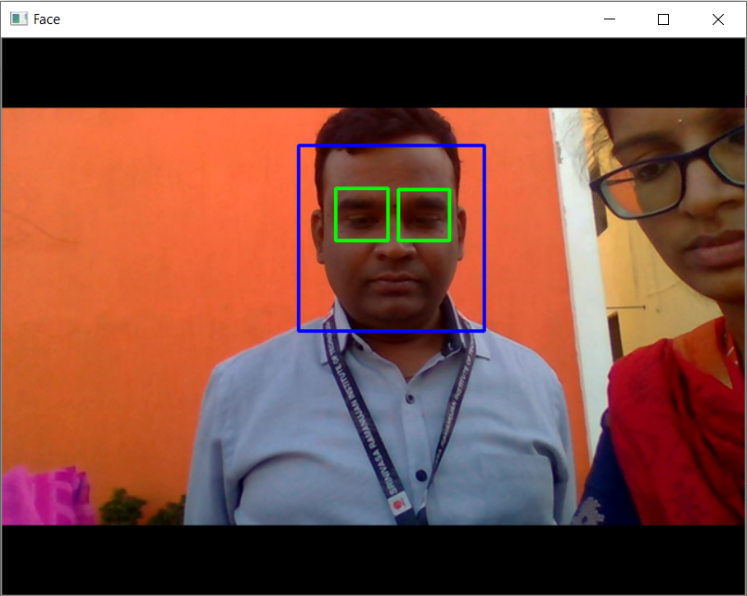
Output face with eye capture

Slide 20
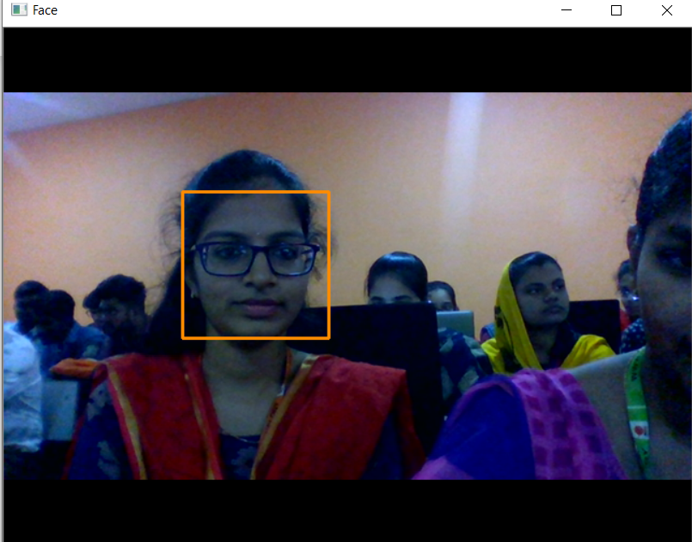
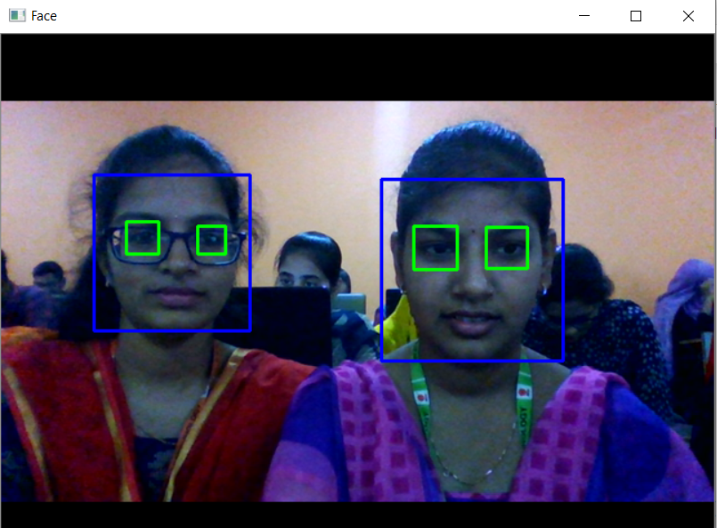
output
Face detect
Multiple faces

Slide 21
THANK YOU
Queries
?

